Slide 1

Feedforward Neural Network for Pattern Classification
CS200 Junior I.S. Thesis
Minhwa Lee
Advised by Dr. Denise Byrnes

Slide 2
Outline
Definition of Feedforward Neural Network (FNN)
Multilayer Perceptron with Backpropagation
Real-world Applications – Pattern Classification
Analysis of Results
Notes:
These are

Slide 3
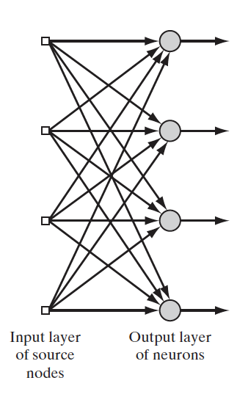
What is Feedforward Neural Network (FNN)?
Input 1 = 1
Artificial Neural network (ANN)
Analogy to the human brain system
"Learning process" through repetitions
Synaptic weights (w)
Feedforward Type of ANNs
Only from left to right, and layer by layer
Single-layer Feedforward Neural Network (SFNN)
Consists of input and output layer
W (1,3)
Input 3 = 3
W (3, 3)
Output 3
Figure 1. SFNN (Haykin, 2004)
Notes:
So, the ANN is defined as an algorithm that mimics the way that
the human brain solves a given problem through a repetition of doing certain task – we call this entire process as “learning process” for the neural network.
Also, as you see on the figure 1, each directed edge has a synaptic weight which is then multiplied with the corresponding input value, Those multiplied values flow through the network to output units.
FNN is a type of ANNs whose learning process works in feedforward direction, which means the input signals go from only left to right, and layer by layer, but not in backward direction.
Figure 1 is a single layer FNN. It is composed of only input and output layer.

Slide 4
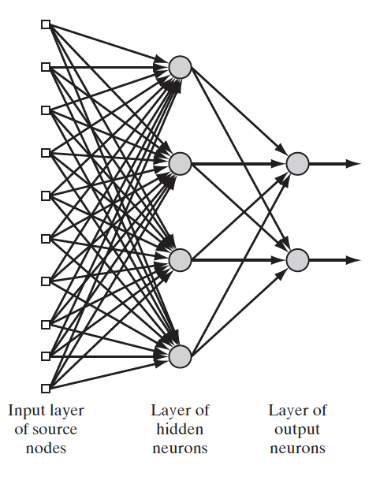
Multilayer Perceptron (MLP)
Same as a Multilayer FNN but used for pattern classification
One or more hidden layers
How to minimize error
Backpropagation
Figure 2. MLP (Haykin, 2004)
Notes:
Another type of FNN is we call multilayer perceptron. It is same as a multilayer FNN but usually used for pattern classification tasks.
The MLP also works in forward direction, but as you see on Figure 2, there are one or more hidden layers in the network, which is the main difference between the MLP and simple FNN.
So, it performs well even under nonlinear separable settings, that means it works well for data whose variables are not necessarily linear related.
But there are also a problem of this network. Since there are hidden neurons between the input and output layer, the network should choose the optimal combinations of inputs and weights to give the best result for the classification tasks. This should require a process that minimizes the error. And the solution is we call backpropa gation.

Slide 5
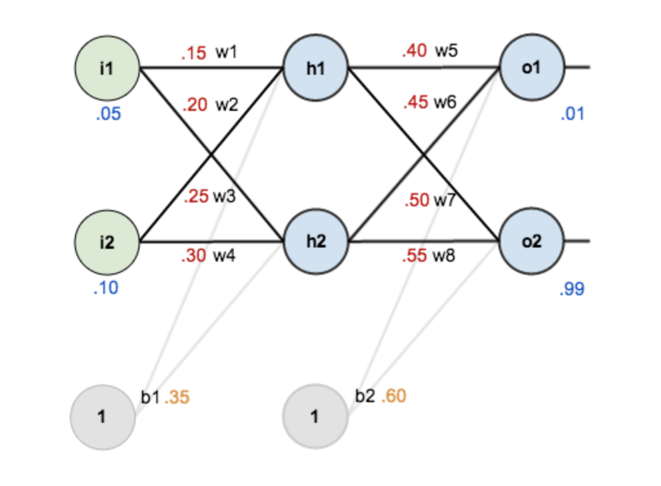
Backpropagation
1. Randomly initialize weights
2. Forward propagation
Calculate the output for ‘output 1’ and ‘output 2’
Compute the error (target output – computed output)
3. Move backward
Output to Hidden to Input layer
Compute how a change in each weight impacted the total error
4. Update each weight
Updated w1 = initialized w1 – (impact of w1 on total Error)
Figure 3. MLP (Mazur, 2015)
Notes:
So how does it work?
First step is to randomly initialize weights on every directed edges of the network
Then we do forward propagation process, which is that we have to calculate the output for each units on output layer. You see that o1 and o2 are on the output layer. We calculate the output value for each of these units.
Then, we calculate the error, which is the difference between the target output value and the computed value from the previous step.
Along with this total error, we move backward. This is the main step of backpropagation. We go from output to hidden to input layer in this order, and we compute how a change in each weight impacts total error that we’ve computed in the forward propagation step.
After calculating the impact of w1 on total error, we subtract this value from the initialized weight, which gives an updated weight value.
Following those process, then we run this process again and again until the error is sufficient to be small as possible. Then we stop.

Slide 6
Real-world Applications of FNN
Case 1: Iris classification
Case 2: Prediction of high risk of suicide
UCI Machine Learning
150 total cases in the data set
3 classes – Setosa, Versicolor, and Virginica
Training process
Training set 70 % and Testing set 30%
Korean national web-survey for youths in 2019
Take a sample of only 1777 cases (5%)
Two classes – High-Risk or not
Training process
Training set 70 % and Testing set 30%
Notes:
Now, I am going to discuss how the real-world problems have been solved by the application of the FNN, especially for multilayer perceptron with backpropagation algorithm.
I’ve done two case studies, the first one is iris classification. This is very famous data set that is imported from UCI machine learning website. The dataset has a total of 150 cases.The column species represents the three classes of the iris plant, which are setosa, versicolor, and virginica.
For the Multilayer perceptron model, I first did training process before making a classification. So I partition the entire dataset into 70% of training set and 30% of the testing set that I applied the MLP model to.
Second case study is to predict the high-risk of suicide among Korean adolescents. This data set is excerpted from The Korean national web-survey done in 2019. for this case study, I just took a sample of only 1777 cases, which are only 5% of the total. There are two classes that we need to classify from the dataset, which are high-risk or not.
Likewise, I also did training process with the multilayer perceptron with backpropagation, and before that separated the entire dataset into 70% training set and 30% of the testing set.

Slide 7
Software Modules
R
Data cleaning (‘dplyr’ package)
Python
Data manipulation (‘pandas’ module)
Neural Network (‘Scikit-learn’ module)
Train_Test_Split (Split the data)
MLPClassifier (MLP with backpropagation)
Plotting (‘matplotlib.pyplot’ module)
Notes:
I used two software for data modeling.
First I used R for data cleaning using dplyr library.
Then, I used Python for entire process.
Especially For training process, I used scikit-learn library which is known for open-source machine learning tools. I imported train-test-split for splitting the data into training set and testing set. Then I used MLPClassifier function to build the MLP model.
Lastly, I used matplotlib library to make a plot.

Slide 8
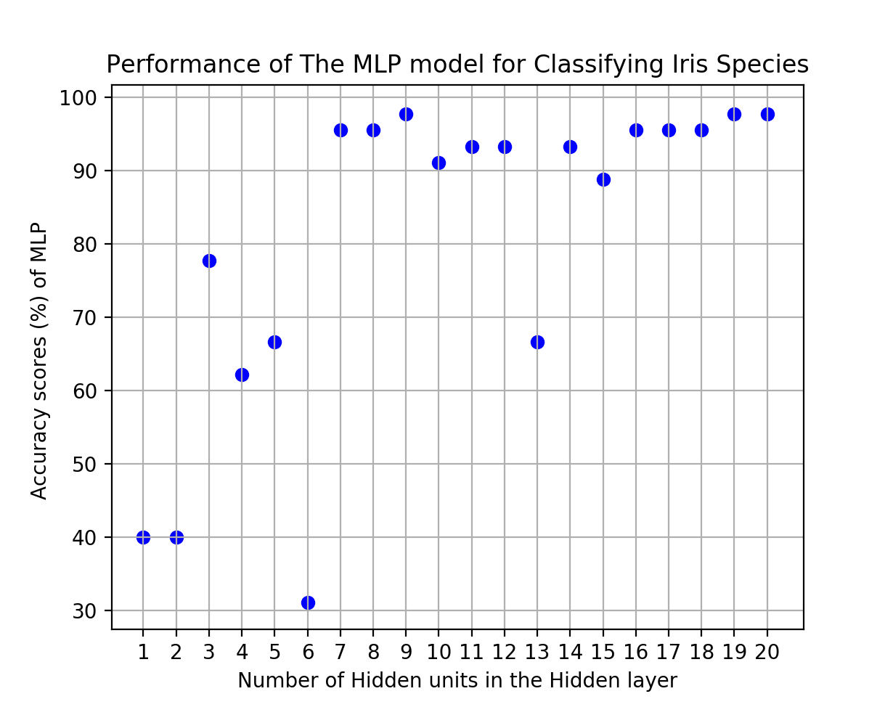
Results – 1) Iris Classification
Table 1. Accuracy Table for Iris Classification
Class | Total | Correctly Classified | Incorrectly Classified
Setosa | 14 | 14 | 0
Versicolor | 18 | 14 | 4
Virginica | 13 | 13 | 0
 |  | Accuracy | 91.11%
Figure 4. Accuracy Plot by different # of hidden units
Notes:
This is the result of iris classification.
As you see on the table, setosa and virginica are all correctly classified, but versicolor gives four incorrectly classified cases. The accuracy rate is 91%.
I also looked over the accuracy of the MLP model versus the number of hidden units in the hidden layer. The figure shows that accuracy scores tend to become higher as the number of hidden units is greater or equal to 7. Accuracy scores range from 40% to 97.77%.

Slide 9
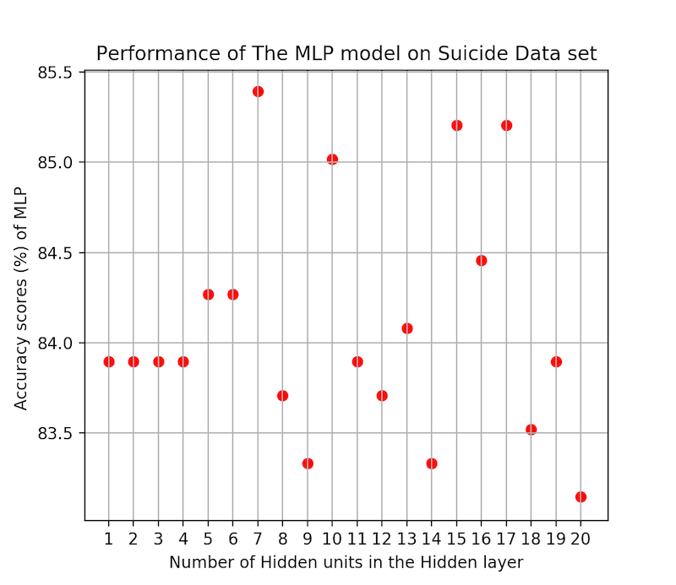
2) Prediction of High-Risk of Suicide
Table 2. Accuracy Table for Suicide Prediction
Class | Total | Correctly Classified | Incorrectly Classified
Not High-Risk | 448 | 444 | 4
High-Risk | 86 | 10 | 76
 |  | Accuracy | 85.02%
Figure 4. Accuracy Plot by different # of hidden units
Notes:
And this is the result of suicide data classification.
So, the model classified correctly almost cases for those who are not at high risk of suicide, but the model correctly classified only 10 cases out of 86, so those results give the accuracy of the MLP as 85%.
Likewise, the MLP model gives the highest accuracy when there are 7 hidden units in the hidden layer, which gives an accuracy score of 85%.

Slide 10
Possible Extended Work
Mathematical interpretation of backpropagation
Explore another type of ANNs

Slide 11
Bibliography
Kyunghyun Cho. 2014. Foundations and Advances in Deep Learning. Ph.D. Dissertation. Aalto University; Aalto-yliopisto, Espoo, Finland.
Navdeep Singh Gill. 2019. Artificial Neural Network Applications and Algorithms. Retrieved April 23, 2020 from https://www.xenonstack.com/blog/artificial-neural-network-applications/
Simon Haykin. 2004. Neural Networks and Learning Machines (3rd.ed). Pearson Prentice Hall.
Jung Jun Su, Park Sung Jin, Kim Eun Young, Na Kyoung-Sae, Kim Young Jae, and Kim Kwanggi. 2019. Prediction models for high risk of suicide in Korean adolescents using machine learning techniques. PloS One 14, 6 (Jun. 2019), 1-12. DOI: https://doi.org/10.1371/journal.pone.0217639
Matt Mazur. 2015. A Step by Step Backpropagation Example. Retrieved April 24, 2020 from https://mattmazur.com/2015/03/17/a-step-by-step-backpropagation-example/

Slide 12
Eric Robert. 2000. Neural Network. Retrieved April 25, 2020 from https://cs.stanford.edu/people/eroberts/courses/soco/projects/neural-networks/index.html
Raul Rojas. 1996. Neural Networks: A Systematic Introduction. Springer-Verlag, Berlin, New York. DOI: https://doi.org/10.1007/978-3-642-61068-4.
Frank Rosenblatt. The Perceptron: A Probabilistic Model for Information Storage and Organization in the Brain. Psychological Review 65 (1958), 386-408. DOI: https://doi.org/10.1037/h0042519.
Jürgen Schmidhuber. 2015. Deep learning in neural networks: An overview. Neural Networks 61 (2015), 85-117. DOI: https://doi.org/10.1016/j.neunet.2014.09.003
Madhusmita Swain, Sanjit Dash, Sweta Dash, and Ayeskanta Mohapatra. 2012. An Approach for IRIS Plant Classification Using Neural Network. International Journal on Soft Computing 3 (Mar. 2012), 79-89.

